Slide 1
Customer Churn Analysis

Slide 2
What is Churn?
In a business environment, the term, customer attrition simply refers to the customers leaving one business service to another. Customer churn or subscriber churn is also similar to attrition, which is the process of customers switching from one service provider to another anonymously.

Slide 3
Why it is a problem?
One of the key aspirations of any telecommunication company is to maintain a loyal customer base but since the customers have been provided with facility of switching from one service provider to another, telecommunication companies‘ are facing more problems.
According to a study, acquiring a new customer is about 5-6 times costlier as compared to retaining an old one.
Customer churn is one of the major issues that the telecom industry is facing today. Hence customer churn may prove to be a costly risk if not managed carefully.
Various costs are associated with customer churn and include loss of revenue, costs of customer retention and reacquisition, advertisement costs, organizational as well as planning and budgeting chaos.
Therefore it becomes quite necessary to identify the possible churning customers so that the losses can be prevented.

Slide 4
Hypothesis
H0: There is no relationship between Gender and customer churn
Ha: There is a relationship between Gender and customer churn
H0: There is no relationship between SeniorCitizen and customer churn
Ha: There is a relationship between SeniorCitizen and customer churn
H0: There is no relationship between Partner and customer churn
Ha: There is a relationship between Partner and customer churn
H0: There is no relationship between Dependents and customer churn
Ha: There is a relationship between Dependents and customer churn
H0: There is no relationship between Tenure and customer churn
Ha: There is a relationship between Tenure and customer churn

Slide 5
Hypothesis
H0: There is no relationship between PhoneService and customer churn
Ha: There is a relationship between PhoneService and customer churn
H0: There is no relationship between OnlineSecurity and customer churn
Ha: There is a relationship between OnlineSecurity and customer churn
H0: There is no relationship between OnlineBackup and customer churn
Ha: There is a relationship between OnlineBackup and customer churn
H0: There is no relationship between DeviceProtection and customer churn
Ha: There is a relationship between DeviceProtection and customer churn
H0: There is no relationship between TechSupport and customer churn
Ha: There is a relationship between TechSupport and customer churn

Slide 6
Hypothesis
H0: There is no relationship between StreamingTV and customer churn
Ha: There is a relationship between StreamingTV and customer churn
H0: There is no relationship between StreamingMovies and customer churn
Ha: There is a relationship between StreamingMovies and customer churn
H0: There is no relationship between Contract and customer churn
Ha: There is a relationship between Contract and customer churn
H0: There is no relationship between PaperlessBilling and customer churn
Ha: There is a relationship between PaperlessBilling and customer churn
H0: There is no relationship between PaymentMethod and customer churn
Ha: There is a relationship between PaymentMethod and customer churn

Slide 7
Hypothesis
H0: There is no relationship between MonthlyCharges and customer churn
Ha: There is a relationship between MonthlyCharges and customer churn
H0: There is no relationship between TotalCharges and customer churn
Ha: There is a relationship between TotalCharges and customer churn
H0: There is no relationship between MultipleLines and customer churn
Ha: There is a relationship between MultipleLines and customer churn
H0: There is no relationship between InternetService and customer churn
Ha: There is a relationship between InternetService and customer churn

Slide 8
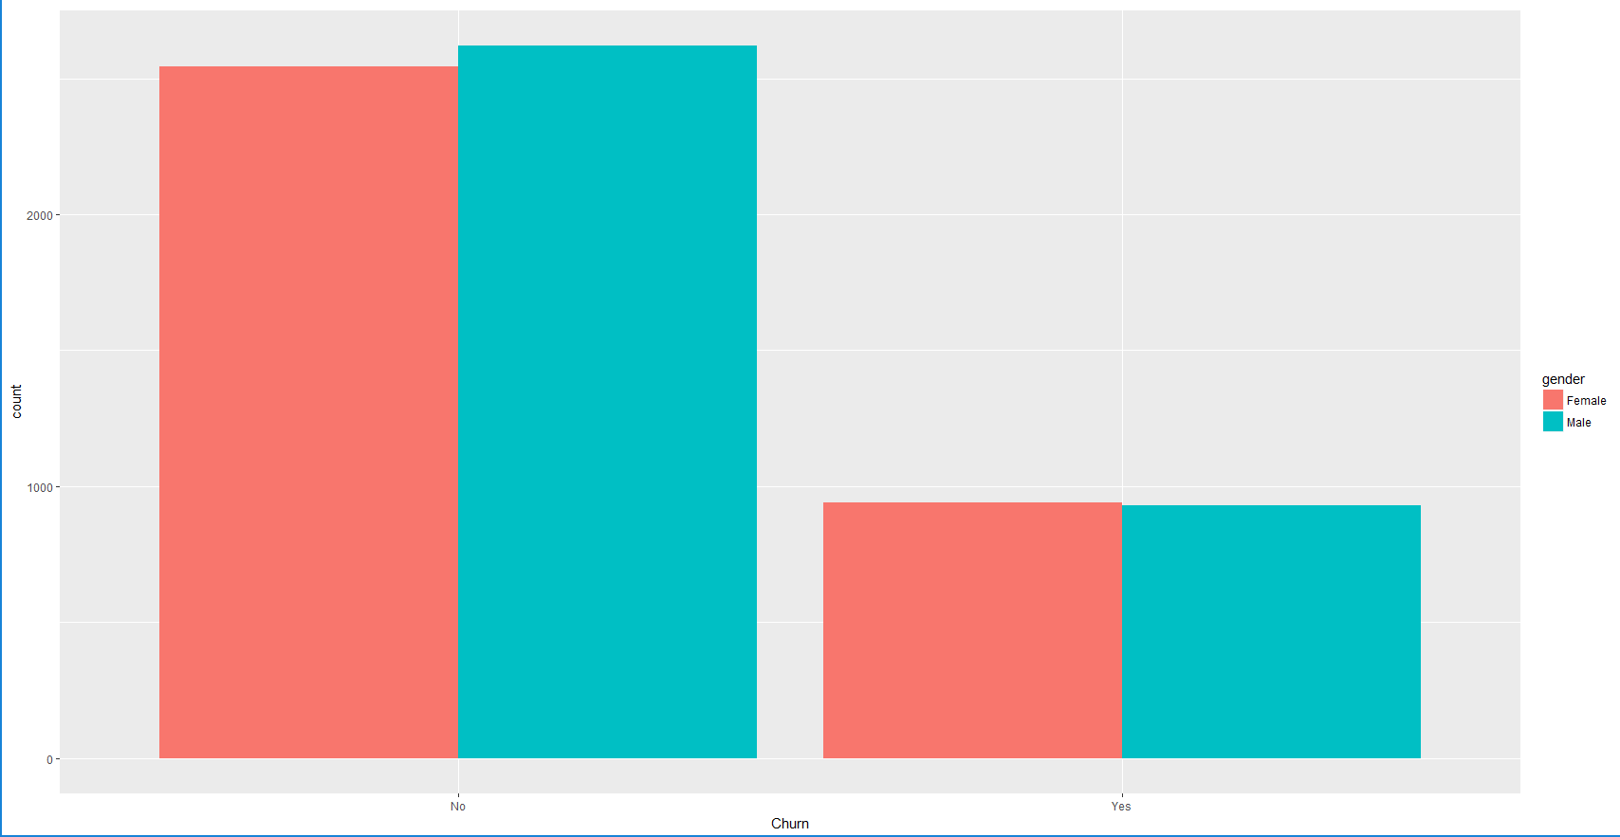
Exploratory Data Analysis
We see equal proportion for both Male and Female across Churners and Non Churners. In Non Churners, the number of Male slightly higher then the number of Female

Slide 9
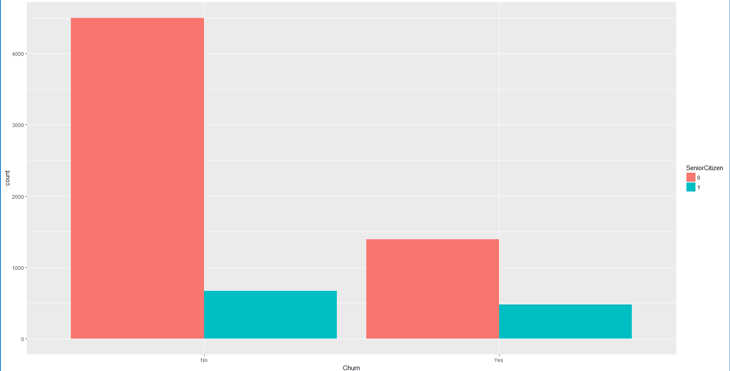
Exploratory Data Analysis
Low proportion of both Churners and Non Churners among SeniorCitizen.

Slide 10
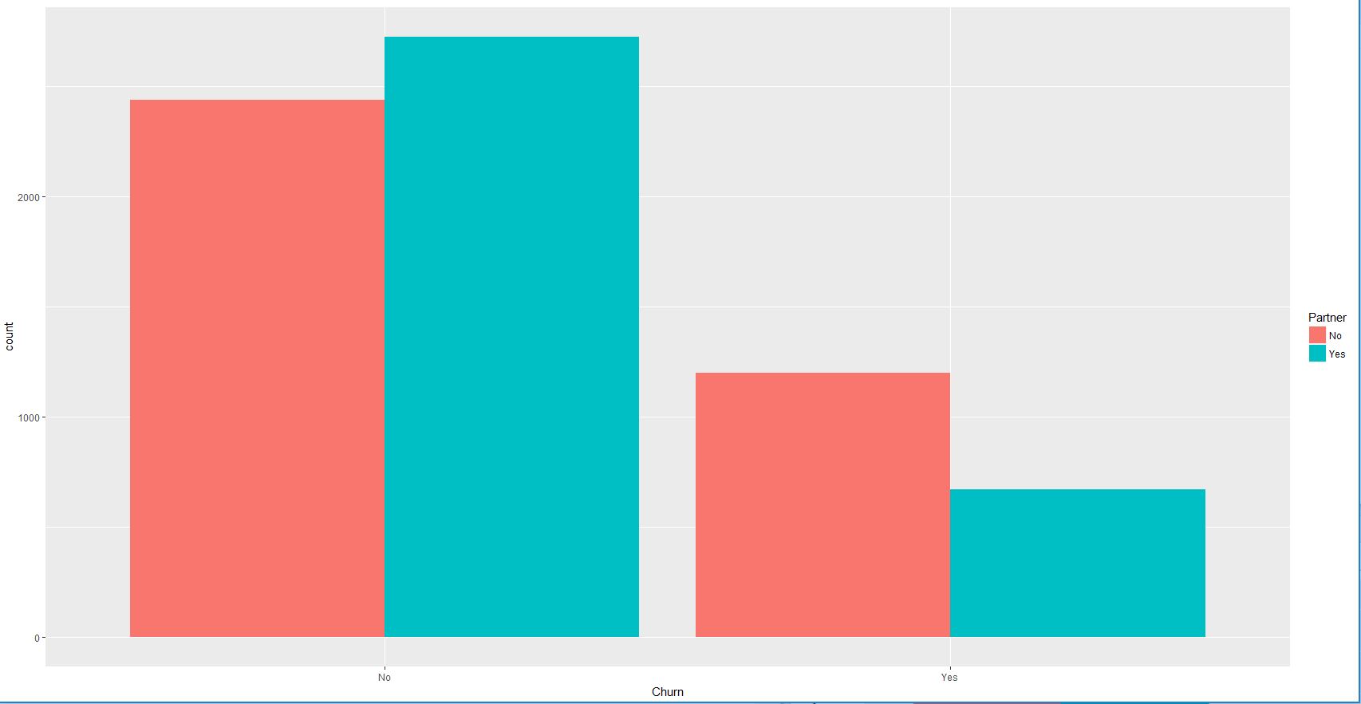
Exploratory Data Analysis
Non Churners having more Partners. Churners having less Partners.

Slide 11
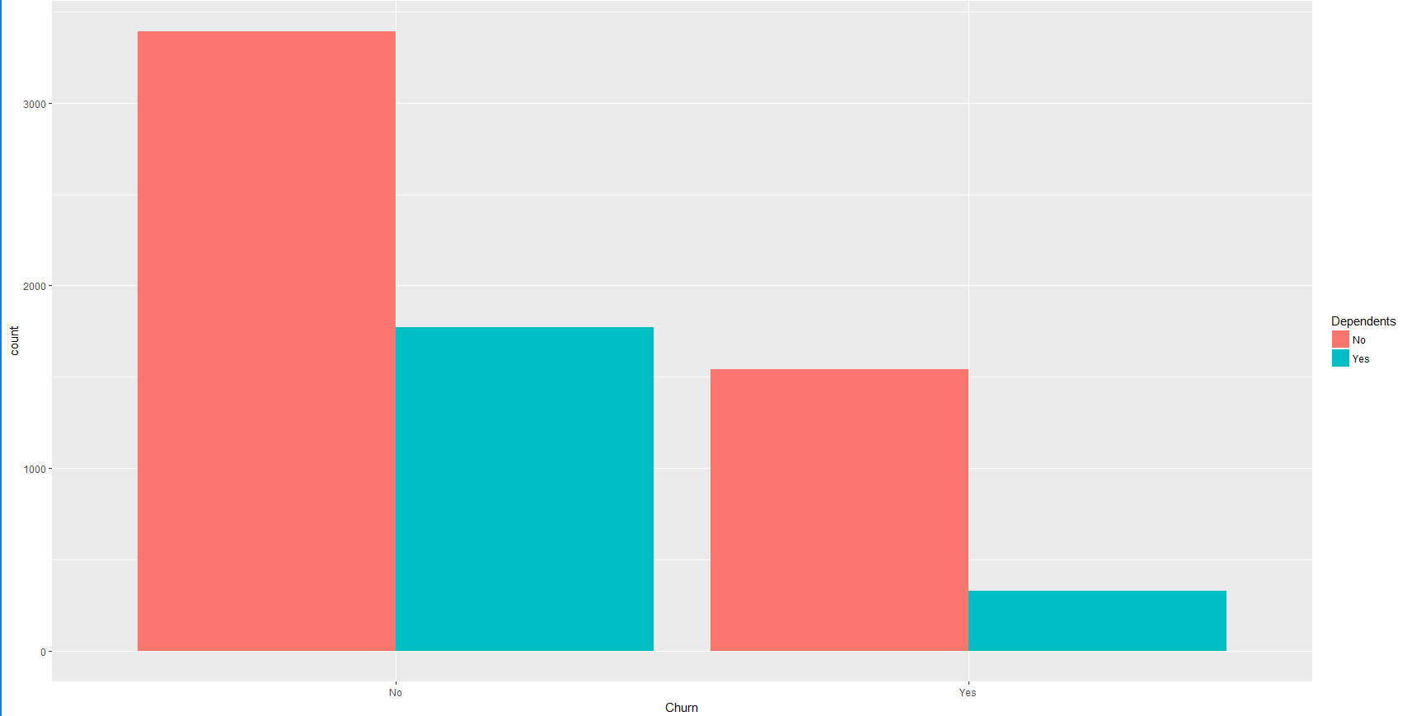
Exploratory Data Analysis
Non Churners having relatively more Dependents. Churners having relatively very less Dependents.

Slide 12
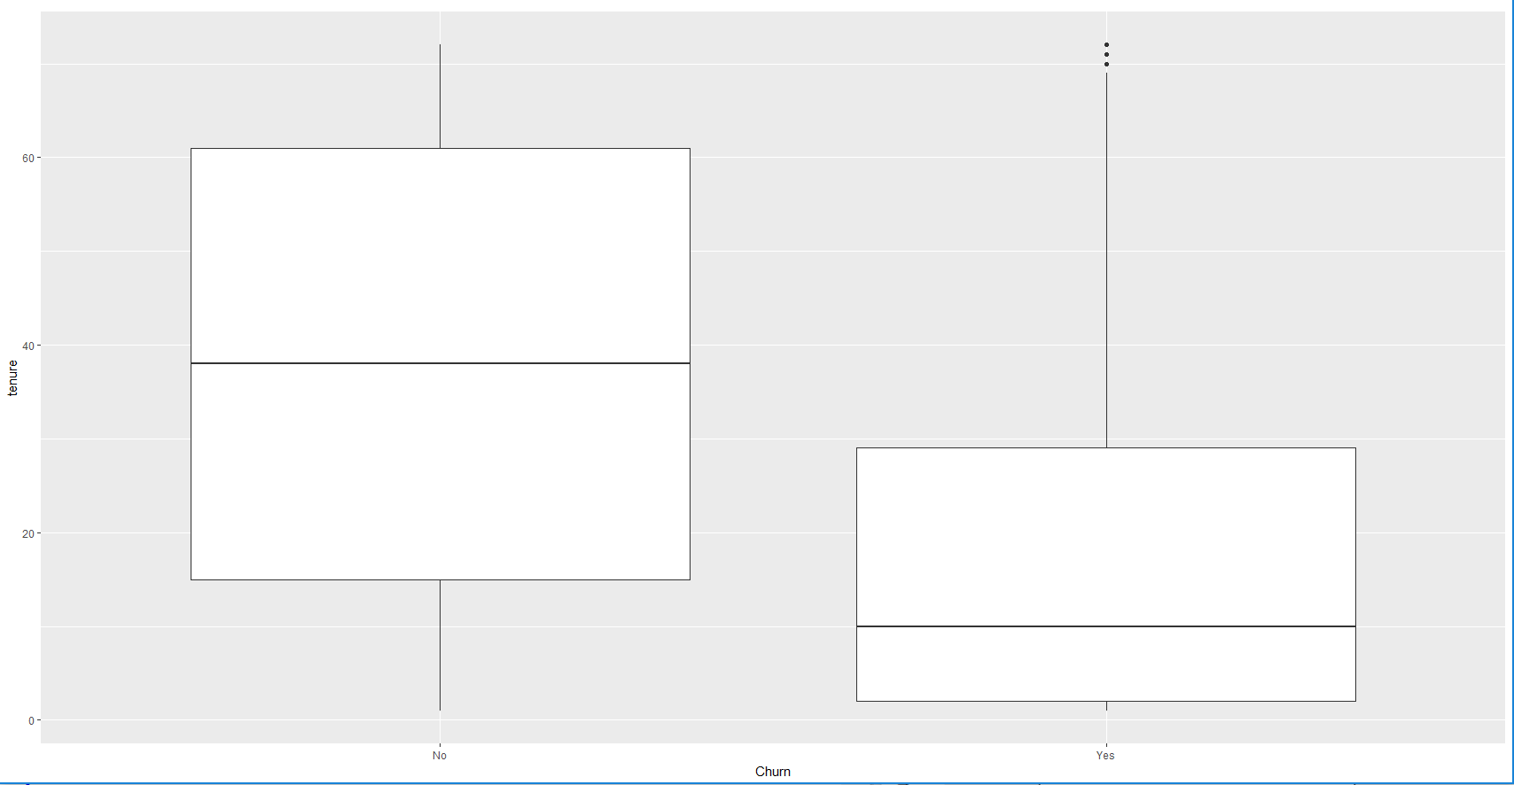
Exploratory Data Analysis
Non Churners on the higher side of tenure. Churners on the lower side of tenure.

Slide 13
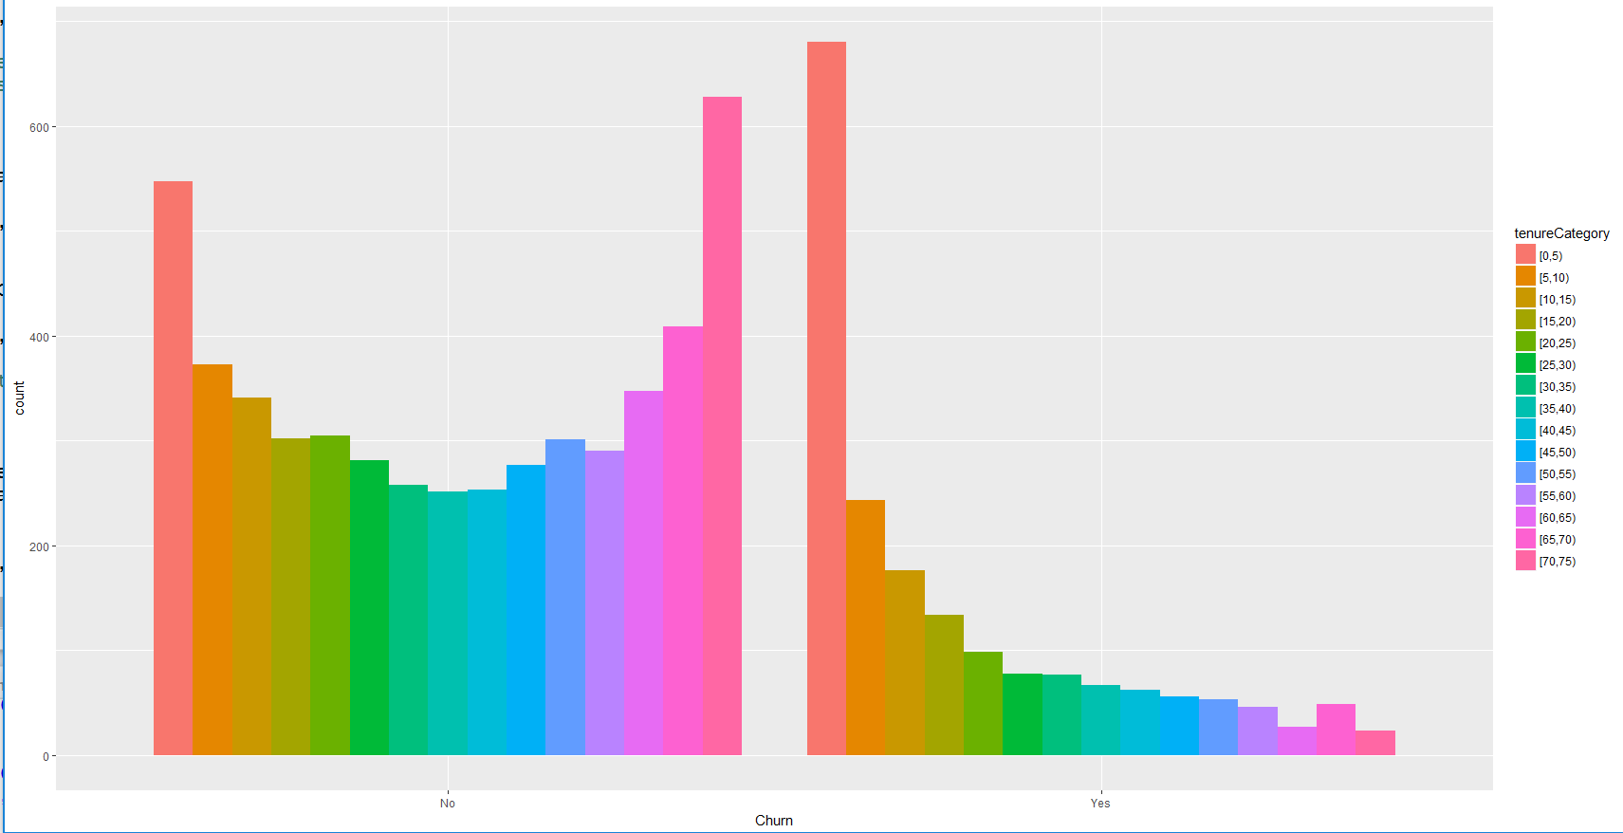
Exploratory Data Analysis
Non Churners on the higher side of tenure. Churners on the lower side of tenure.

Slide 14
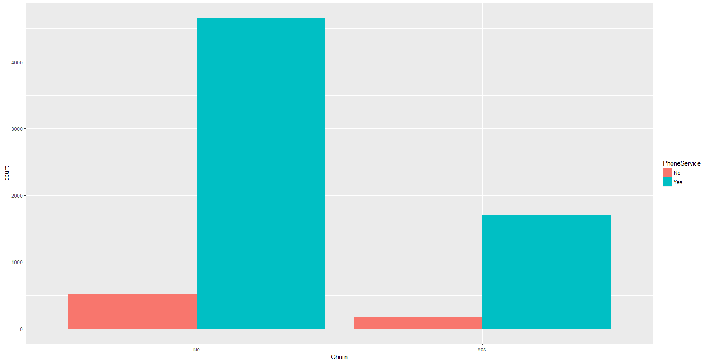
Exploratory Data Analysis
PhoneService has higher representation in both Churn and No Churn

Slide 15
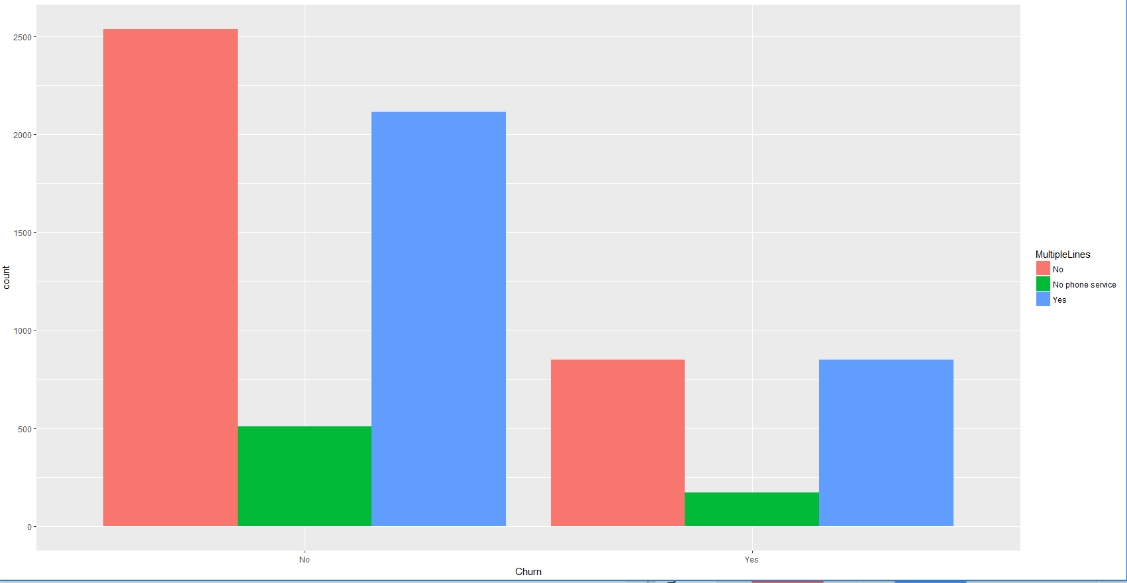
Exploratory Data Analysis
Churners and Non Churners having relatively higher proportion of No/Yes Multiple Lines

Slide 16
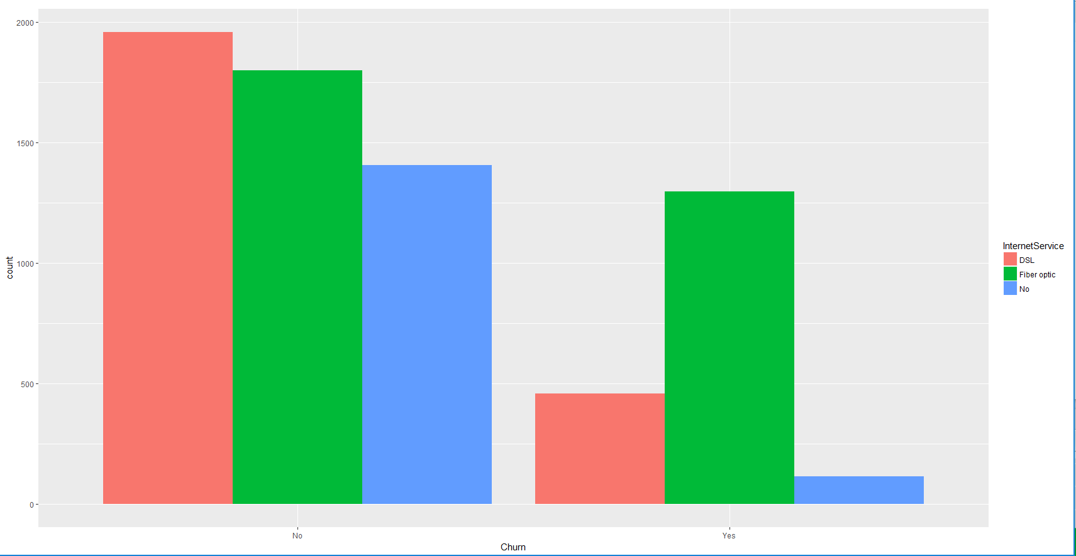
Exploratory Data Analysis
Churners and Non Churners having relatively higher proportion of Fiber optic. Churners low on DSL and No InternetService. Non Churners high on DSL and high on No Internet Service.

Slide 17
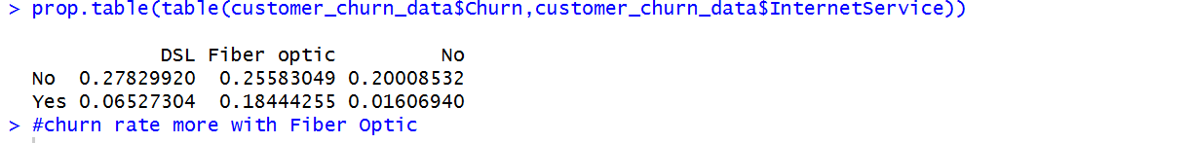
Exploratory Data Analysis

Slide 18
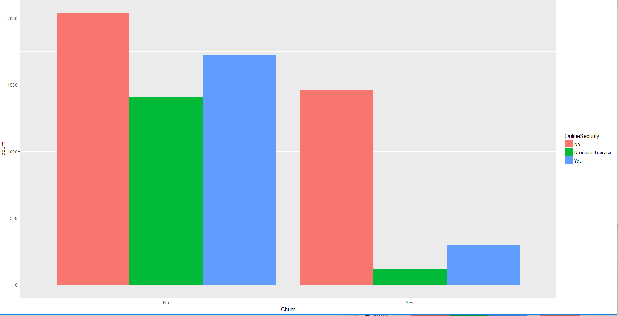
Exploratory Data Analysis
Churners low on OnlineSecurity. Non Churners high on OnlineSecurity.

Slide 19
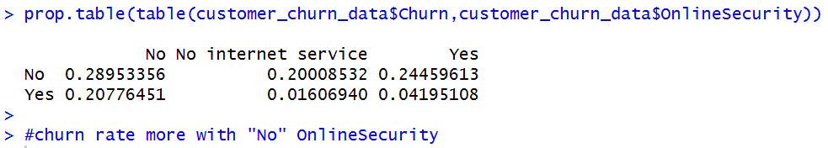
Exploratory Data Analysis
Churn and OnlineSecurity

Slide 20
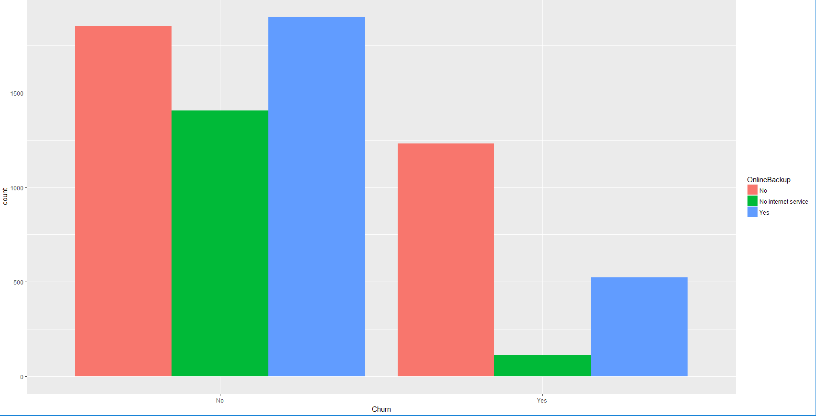
Exploratory Data Analysis
Churners low on OnlineBackup. Non Churners high on OnlineBackup.

Slide 21
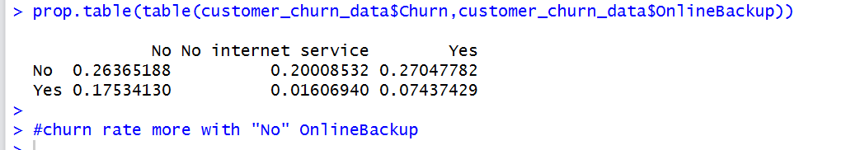
Exploratory Data Analysis
Churn and OnlineBackup

Slide 22
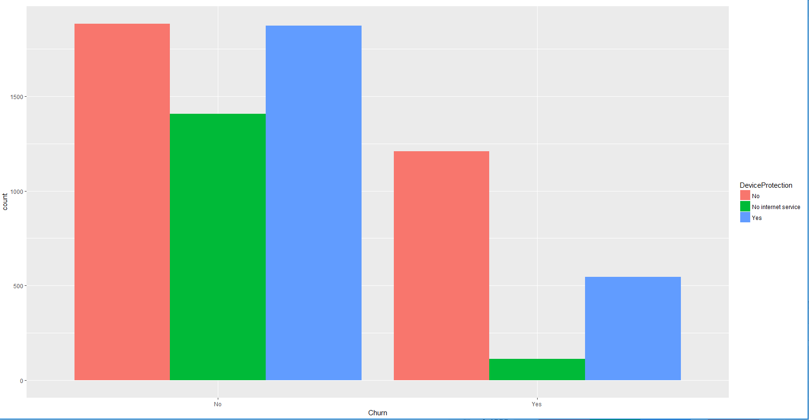
Exploratory Data Analysis
Churners high on No DeviceProtection. Non Churners high on DeviceProtection and no DeviceProtection

Slide 23
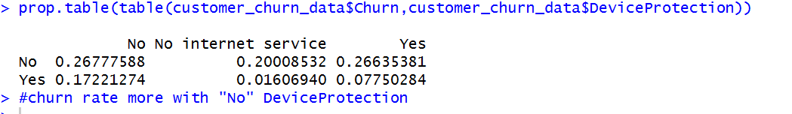
Exploratory Data Analysis
Churn and DeviceProtection

Slide 24
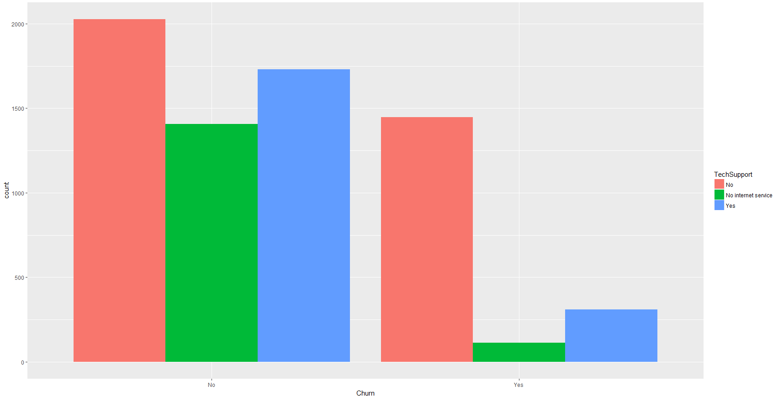
Exploratory Data Analysis
Churners low on No TechSupport. Non Churners high on TechSupport

Slide 25
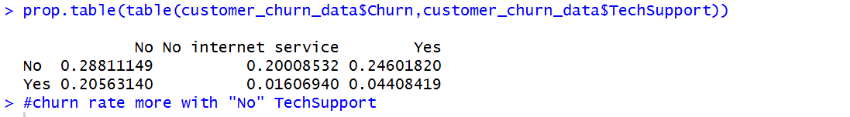
Exploratory Data Analysis
Churn and TechSupport

Slide 26
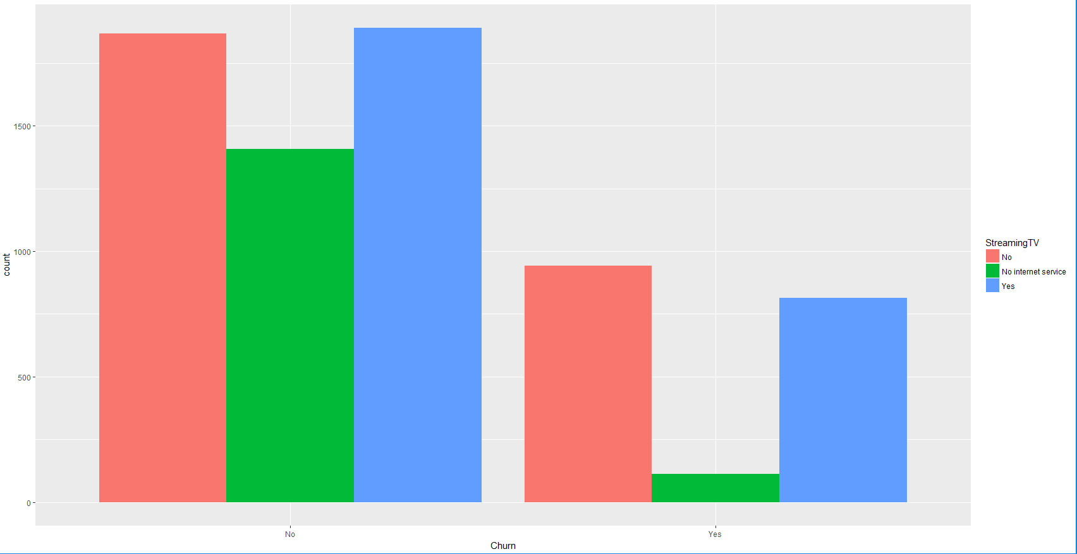
Exploratory Data Analysis
Churners low on No/Yes StreamingTV. Non Churners high on No/Yes StreamingTV

Slide 27
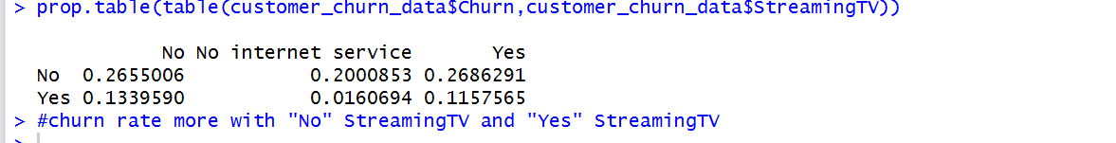
Exploratory Data Analysis
Churn and StreamingTV

Slide 28
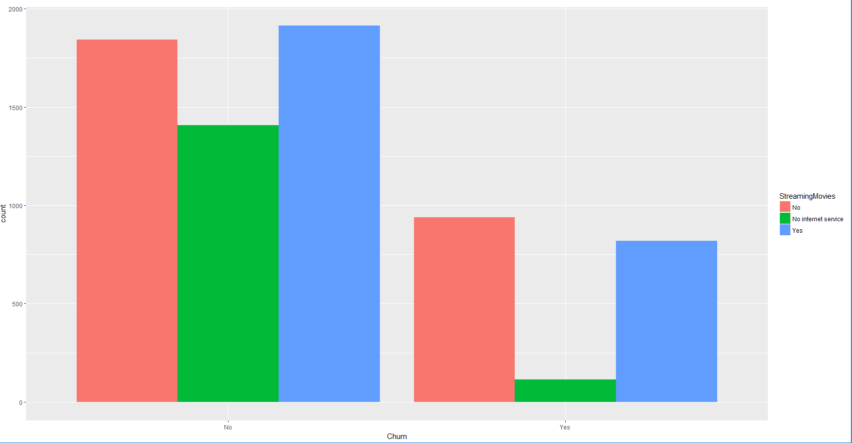
Exploratory Data Analysis
Churners low on No/Yes StreamingMovies. Non Churners high on No/Yes StreamingMovies.

Slide 29
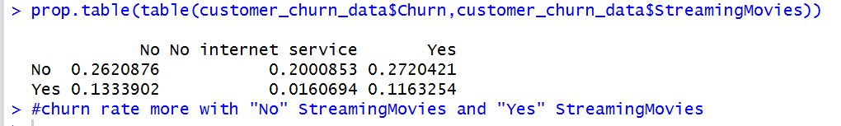
Exploratory Data Analysis
Churn and StreamingMovies

Slide 30
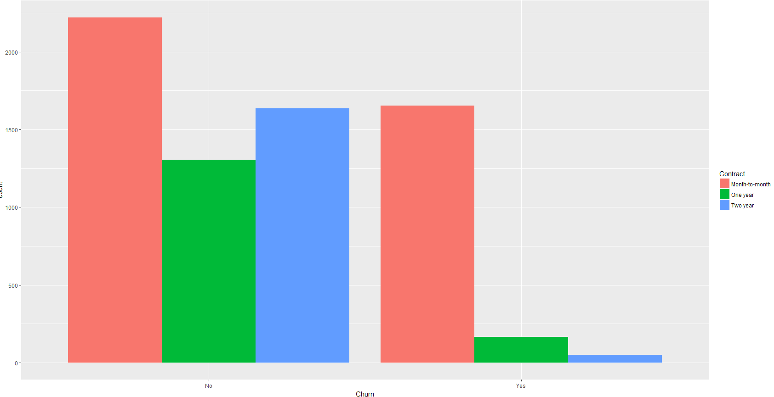
Exploratory Data Analysis
Non Churners High on Month to month/One Year/ Two Year Contract. Churners are high on the Month to Month Contract.

Slide 31
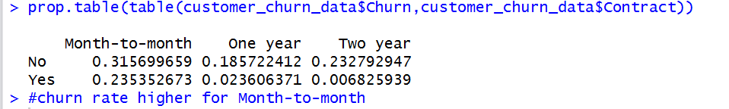
Exploratory Data Analysis
Churn and Contract

Slide 32
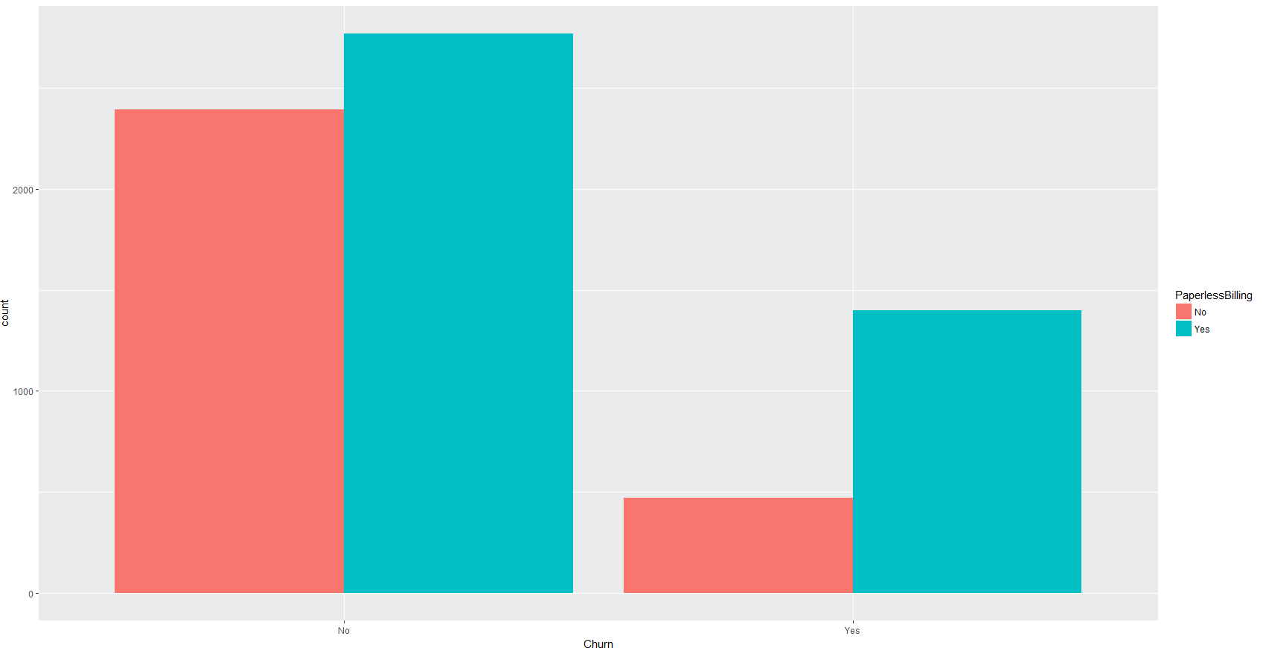
Exploratory Data Analysis
Churn rate higher for "Yes: PaperlessBilling

Slide 33
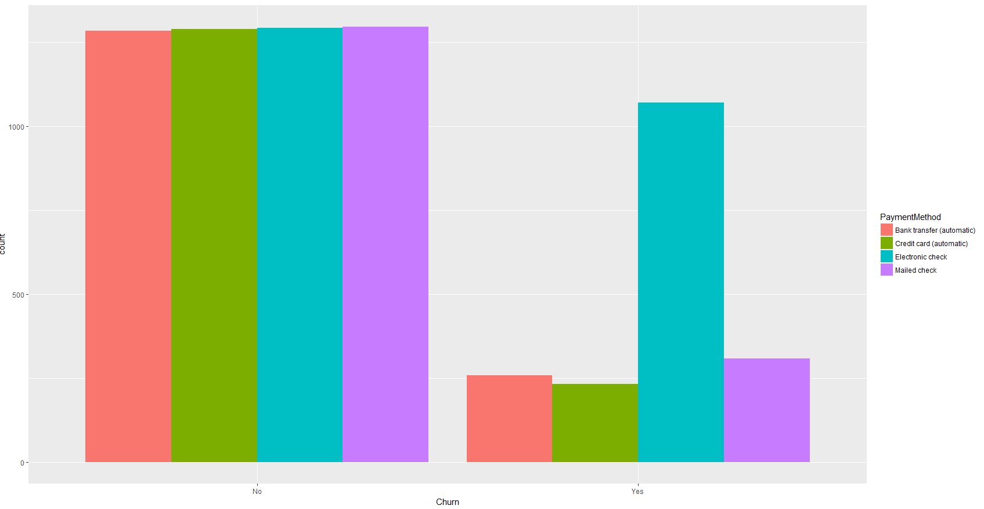
Exploratory Data Analysis
Churn rate higher for “Electronic check: PaymentMethod”

Slide 34
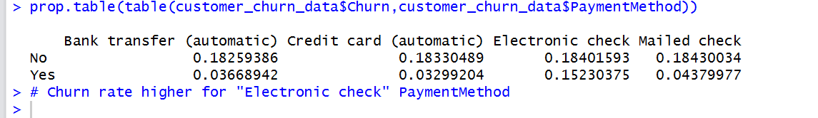
Exploratory Data Analysis
Churn and PaymentMethod

Slide 35
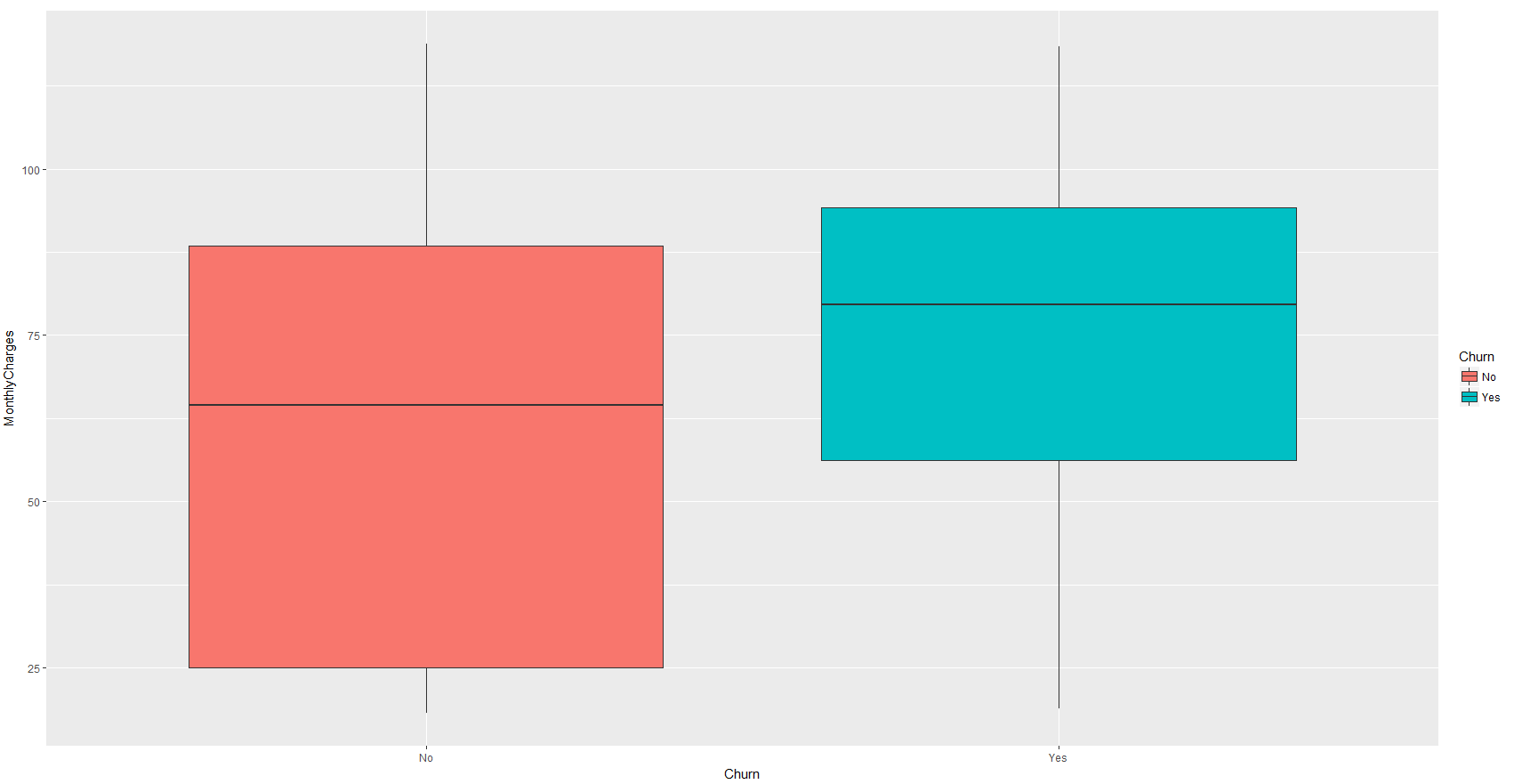
Exploratory Data Analysis
Churn rate higher for high Monthly Charges

Slide 36
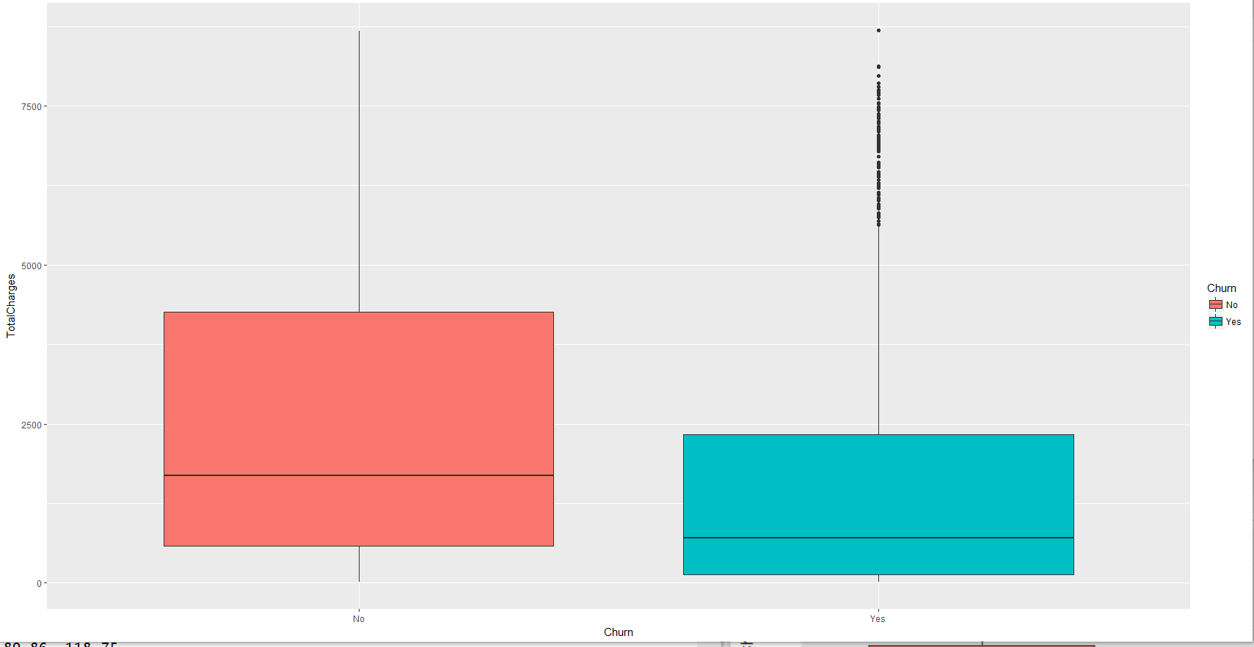
Exploratory Data Analysis
Churn rate higher for low TotalCharges

Slide 37
Exploratory Data Analysis
Correlation between monthlycharges and totalcharges

Slide 38
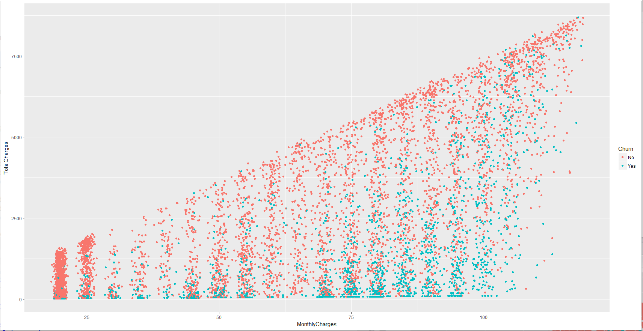
Exploratory Data Analysis
Churners are more concentrated on low total charges and high monthly charges

Slide 39
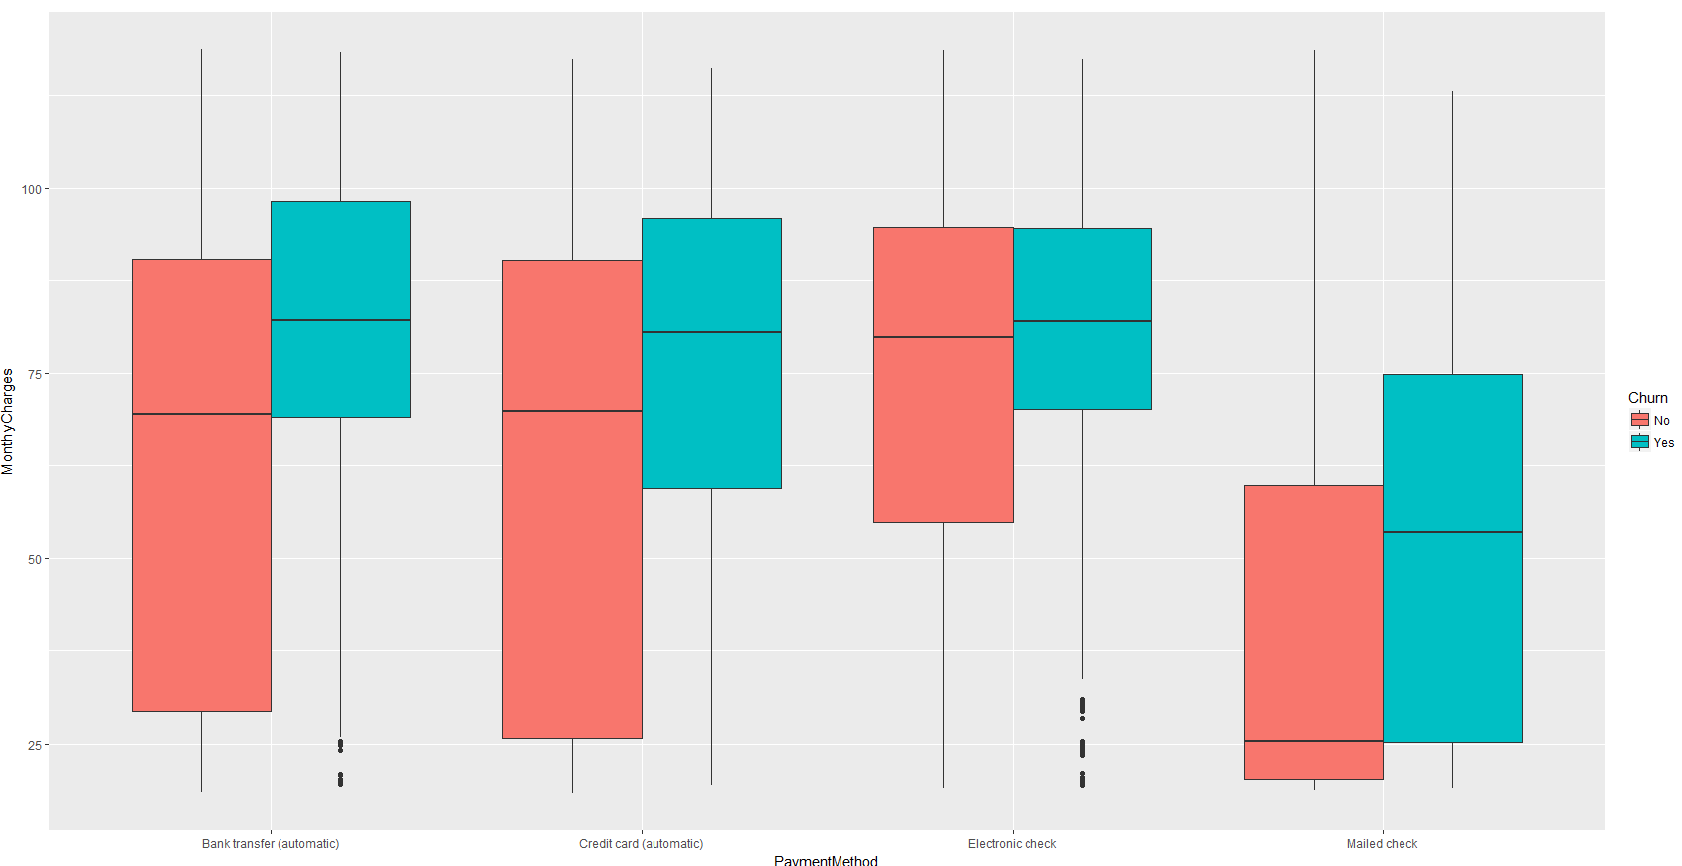
Exploratory Data Analysis
Churn rate high for higher monthly charges across the 3 payment methods Bank Transfer/Credit Card/ Electronic Check

Slide 40
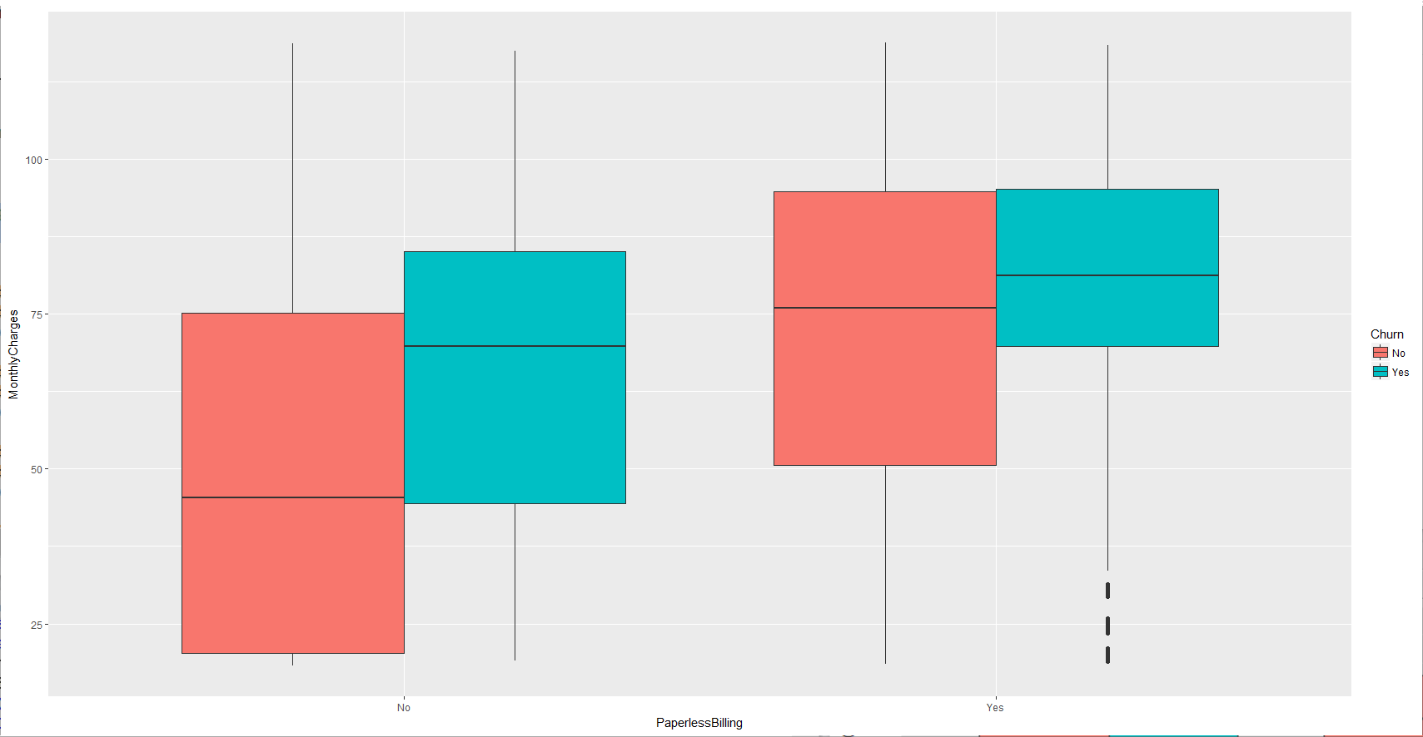
Exploratory Data Analysis
Churn rate higher for high monthlycharges

Slide 41
Exploratory Data Analysis
Chi Square test
Gender and Churn not significant
SeniorCitizen and Churn significant
Partner and Churn significant
Dependents and Churn significant
PhoneService and Churn not significant
MultipleLines and Churn significant
InternetService and Churn significant
OnlineSecurity and Churn significant
OnlineBackup and Churn significant
DeviceProtection and Churn significant
TechSupport and Churn significant

Slide 42
Exploratory Data Analysis
Chi Square test
TechSupport and Churn significant
StreamingTV and Churn significant
StreamingMovies and Churn significant
Contract and Churn significant
PaperlessBilling and Churn not significant
PaymentMethod and Churn significant
tenureCategory and Churn significant
MonthlyChargesCategory and Churn significant
TotalChargesCategory and Churn significant

Slide 43
Exploratory Data Analysis
Anova test for Churn and TotalCharges significant
Anova test for Churn and tenure significant
Anova test for Churn and MonthlyCharges significant

Slide 44
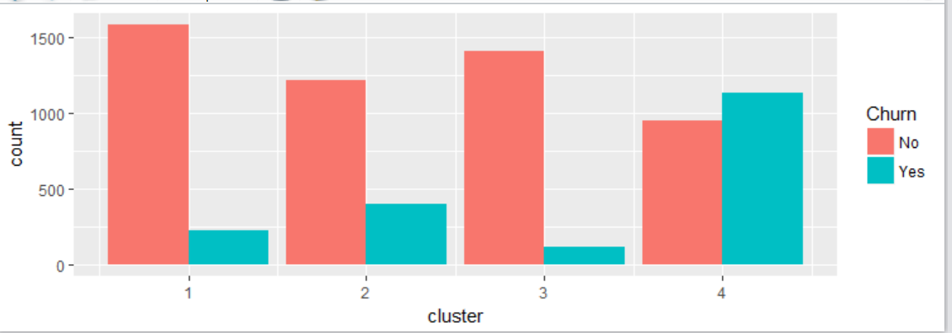
Exploratory Data Analysis
Kmeans clustering with 4 clusters. Fourth cluster has more Churners.

Slide 45
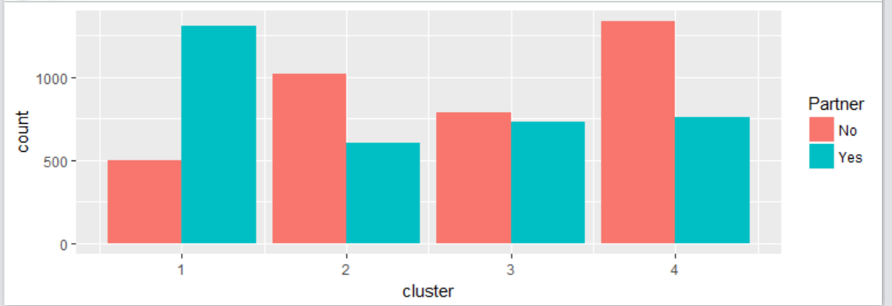
Exploratory Data Analysis
The fourth cluster which has more churners has more “non” Partners

Slide 46
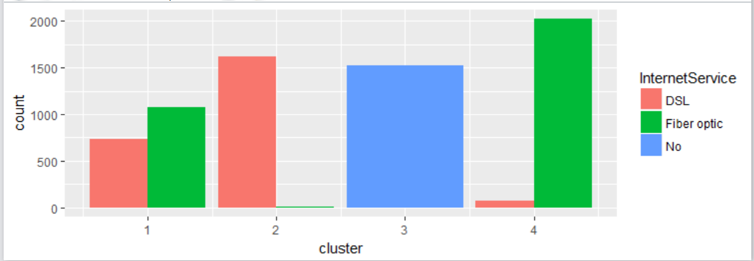
Exploratory Data Analysis
The fourth cluster which has more Churners has higher number of “Fiber optic” InternetService

Slide 47
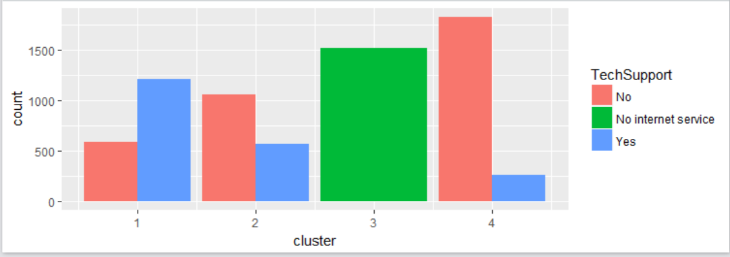
Exploratory Data Analysis
The fourth cluster having more number of Churners has higher number of “No” TechSupport

Slide 48
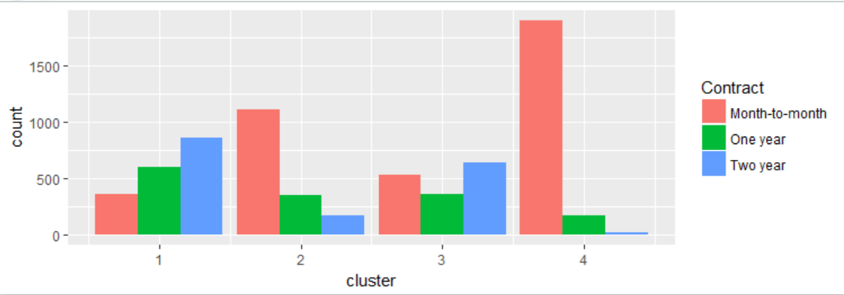
Exploratory Data Analysis
The fourth cluster having more number of Churners has higher number of “Month-to-month” Contract

Slide 49
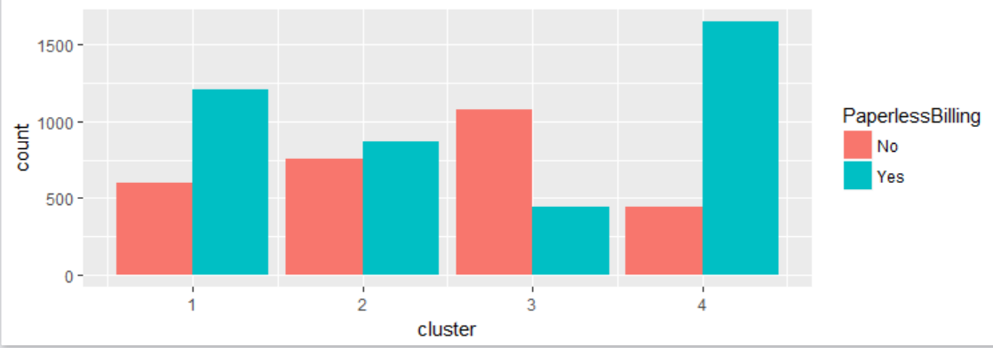
Exploratory Data Analysis
The fourth cluster having more number of Churners has higher number of “Yes” PaperlessBilling

Slide 50
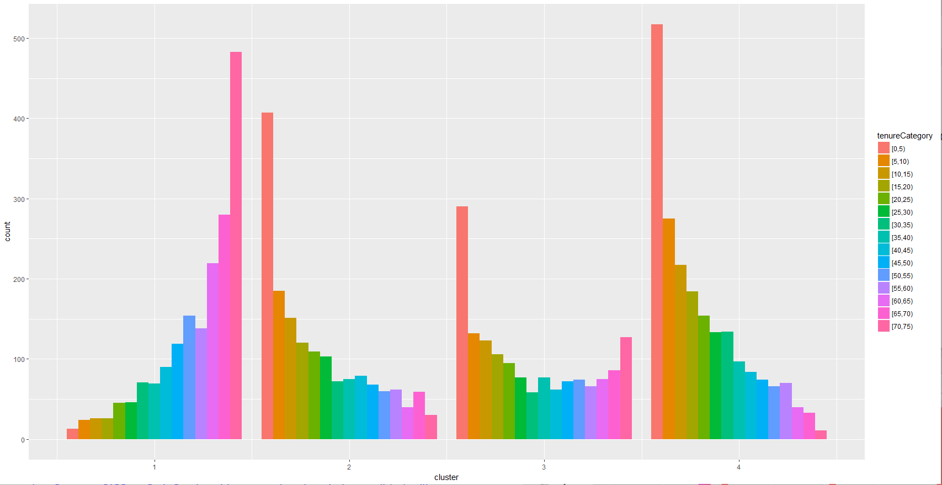
Exploratory Data Analysis
The fourth cluster having more number of Churners has higher number of “0-5” tenureCategory

Slide 51
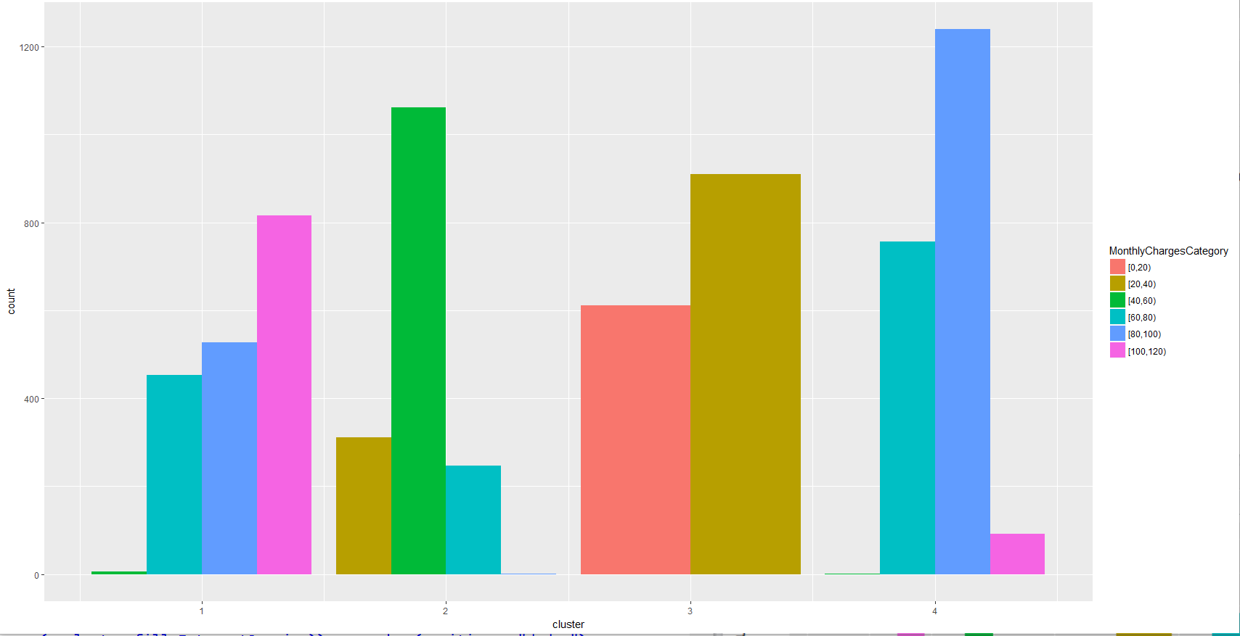
Exploratory Data Analysis
The fourth cluster having more number of Churners has higher number of “60-80”/”80-100” MonthlyChargesCategory

Slide 52
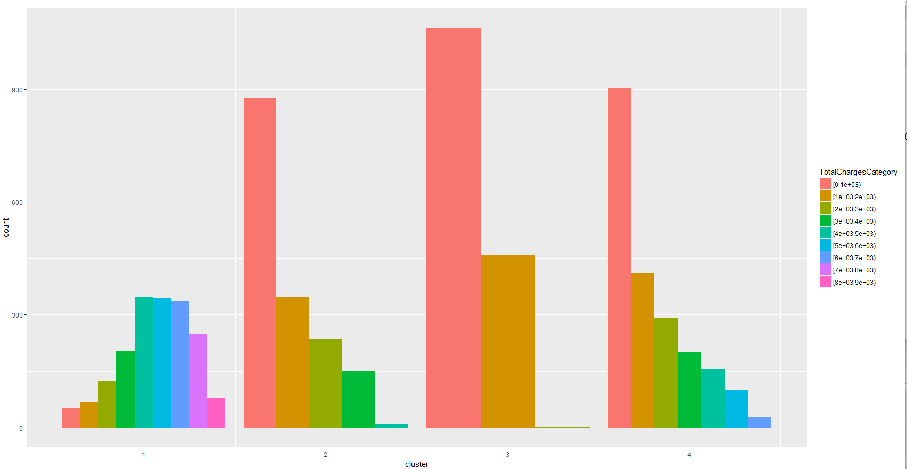
Exploratory Data Analysis
The fourth cluster having more number of Churners has higher number of “lower” totalchargescategory

Slide 53
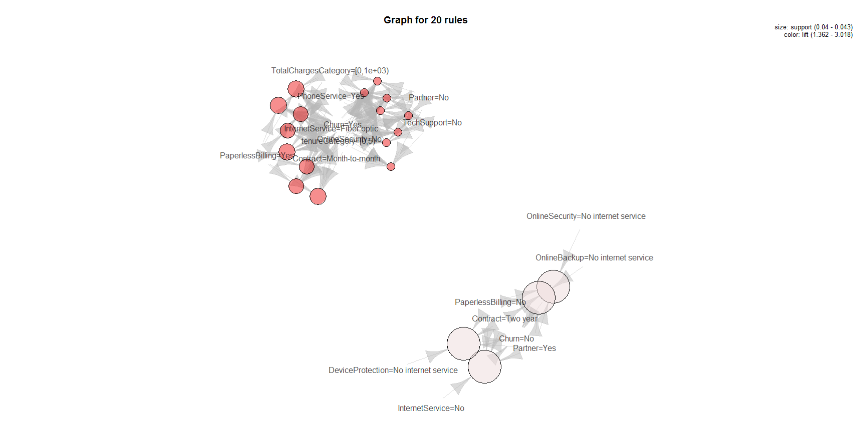
Exploratory Data Analysis
Association Rule mining for Churn and Non Churn

Slide 54
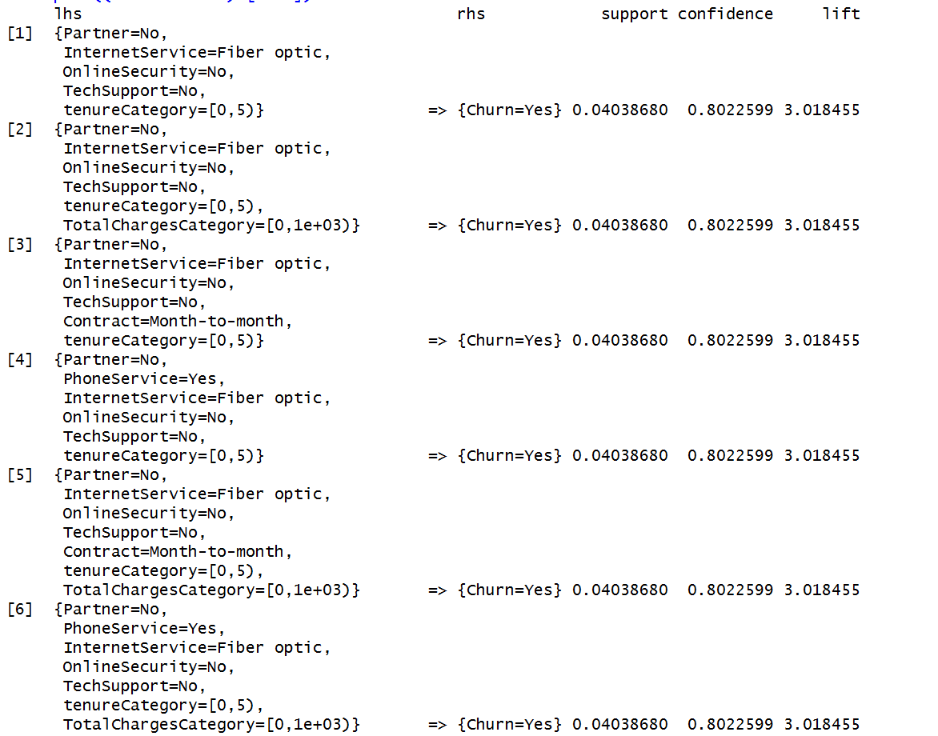
Exploratory Data Analysis
The top 30 rules

Slide 55
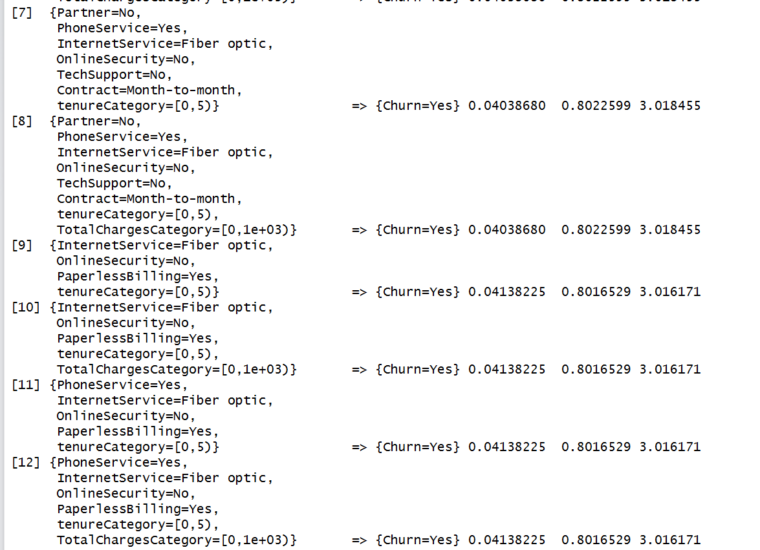
Exploratory Data Analysis
The top 30 rules

Slide 56
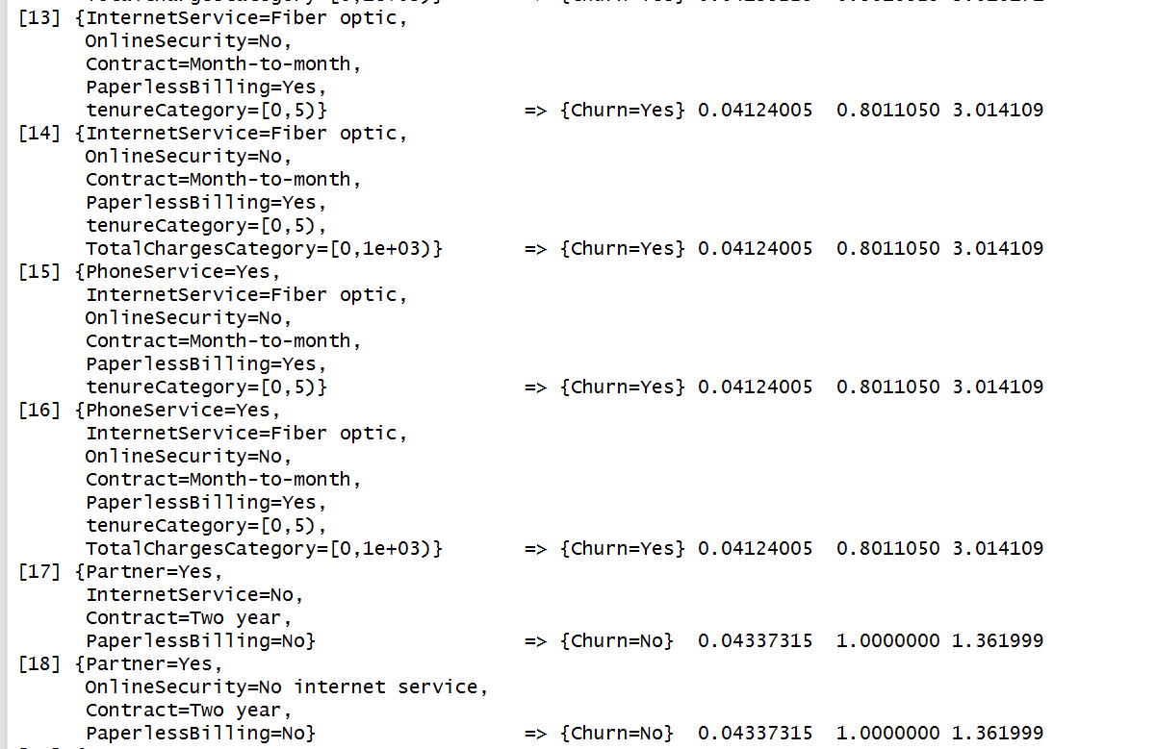
Exploratory Data Analysis
The top 30 rules

Slide 57
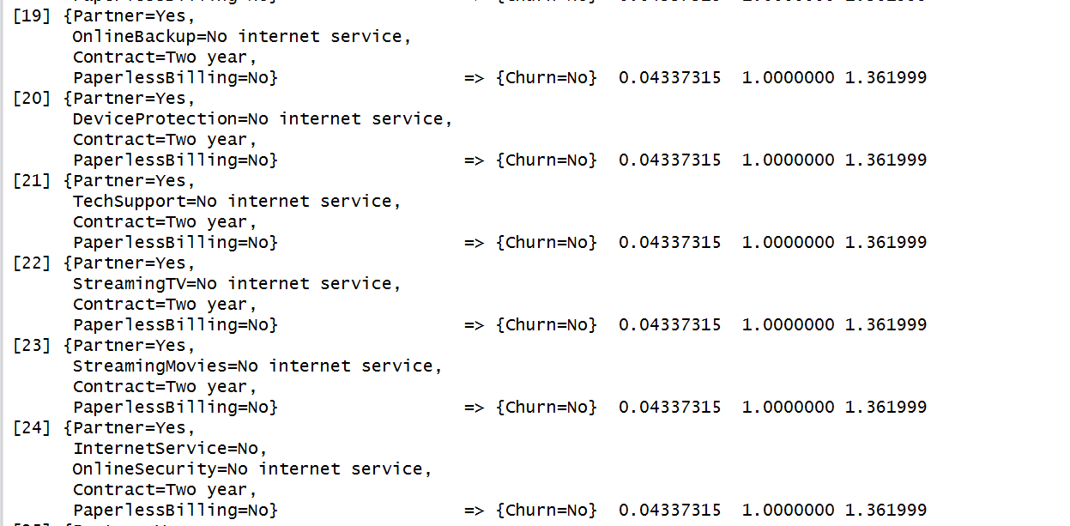
Exploratory Data Analysis
The top 30 rules

Slide 58
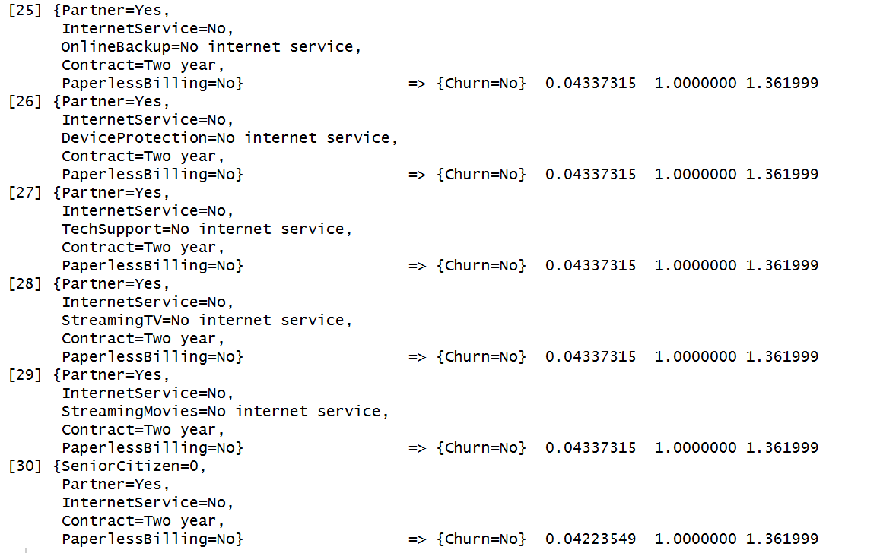
Exploratory Data Analysis
The top 30 rules

Slide 59
Model Development and Validation
Except Tenure, MonthlyCharges and TotalCharges, all other variables are categorical.
We are binning the continuous variable Tenure into 5 units bucket
For all the categorical variables, we will create dummy variables using one hot encoding
With findLinearCombos function from the Caret package, we will find which variables are linear combinations so that we can drop one variable and keep the other variable

Slide 60
Model Development and Validation
findLinearCombos(customer_churn_transformed)
# "InternetServiceNo" "OnlineSecurityNo.internet.service" Linear Combos
# "OnlineBackupNo.internet.service" "InternetServiceNo"
# "DeviceProtectionNo.internet.service" "InternetServiceNo"
# "TechSupportNo.internet.service" "InternetServiceNo"
# "StreamingTVNo.internet.service" "InternetServiceNo"
# "StreamingMoviesNo.internet.service" "InternetServiceNo"
#
# Because of Linear Combination we will not include the below columns:
#
# OnlineSecurityNo.internet.service, OnlineBackupNo.internet.service,
# DeviceProtectionNo.internet.service, TechSupportNo.internet.service
# StreamingTVNo.internet.service, StreamingMoviesNo.internet.service
# "tenureCategoryLabels.2" "tenureCategoryLabels.3"
# "tenureCategoryLabels.4" "tenureCategoryLabels.5"
# "tenureCategoryLabels.6" "tenureCategoryLabels.7"
# "tenureCategoryLabels.8" "tenureCategoryLabels.9"
# "tenureCategoryLabels.10" "tenureCategoryLabels.11"
# "tenureCategoryLabels.12" "tenureCategoryLabels.13"
# "tenureCategoryLabels.14" "tenureCategoryLabels.15"

Slide 61
Building GLM model with top 5 predictors
Using rfe function from caret package, we have the below top 5 predictors:
#Taking only the top 5 predictors
predictors <-
c(
"ContractOne.year",
"ContractTwo.year",
"MonthlyCharges",
"TechSupportYes",
"InternetServiceFiber.optic"
)
model_glm <-
train(trainSet[, names(trainSet) %in% c(predictors)], trainSet[, outcomeName], method =
'glm')

Slide 62
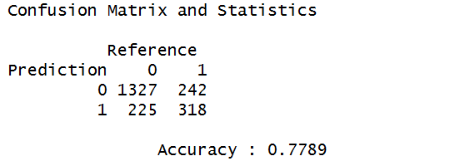


Building GLM model with top 5 predictors
#Predictions
predictions <-
predict.train(object = model_glm, testSet[, names(trainSet) %in% c(predictors)], type =
"raw")
confusionMatrix(predictions, testSet[, outcomeName])

Slide 63
Building GLM model with the below predictors
Predictors:
genderMale, SeniorCitizen,PartnerYes, DependentsYes, PhoneServiceYes,
InternetServiceFiber.optic, InternetServiceNo, DeviceProtectionYes, TechSupportYes,
StreamingTVYes, StreamingMoviesYes, ContractOne.year, ContractTwo.year,
PaperlessBillingYes, PaymentMethodCredit.card..automatic.,
PaymentMethodElectronic.check, tenureCategory..5.10., tenureCategory..10.15.,
tenureCategory..15.20., tenureCategory..20.25., tenureCategory..25.30.,
tenureCategory..30.35., tenureCategory..35.40. , tenureCategory..40.45. ,
tenureCategory..45.50. , tenureCategory..50.55., tenureCategory..55.60. ,
tenureCategory..60.65. , tenureCategory..65.70. , tenureCategory..70.75.,
MonthlyCharges

Slide 64
Building GLM model with the mentioned set of predictors
model_glm <-
train(trainSet[, names(trainSet) %in% c(predictors)], trainSet[, outcomeName], method =
'glm')
#Predictions
predictions <-
predict.train(object = model_glm, testSet[, names(testSet) %in% c(predictors)], type =
"raw")
confusionMatrix(predictions, testSet[, outcomeName])

Slide 65
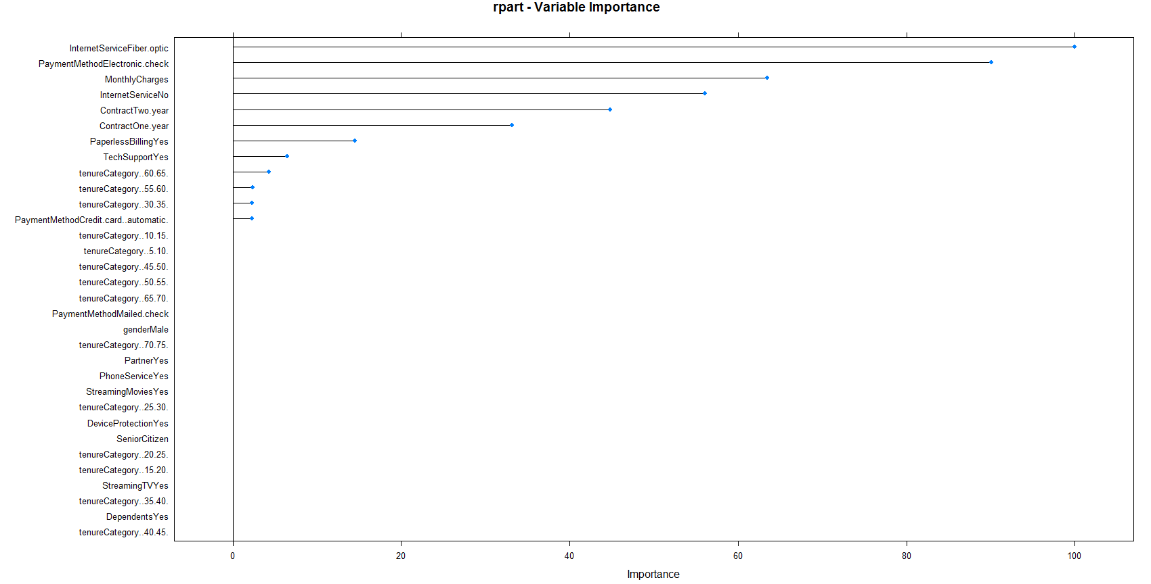
Building CART model with the same set of predictors
#CART
model_rpart <-
train(trainSet[, names(trainSet) %in% c(predictors)], trainSet[, outcomeName], method =
'rpart')

Slide 66
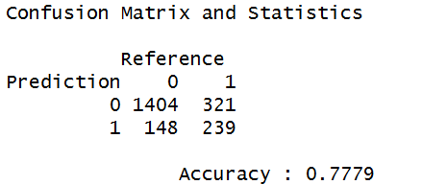


Building CART model with the same set of predictors
#Predictions
predictions <- predict.train(object = model_rpart, testSet[, names(testSet) %in% c(predictors)], type =
"raw")
confusionMatrix(predictions, testSet[, outcomeName])

Slide 67

Building RF model with the same set of predictors
#Random Forest
model_rf <- train(trainSet[, names(trainSet) %in% c(predictors)], trainSet[, outcomeName], method ='rf')

Slide 68



Building RF model with the same set of predictors
#Predictions
predictions <- predict.train(object = model_rf, testSet[, names(testSet) %in% c(predictors)], type = "raw")
confusionMatrix(predictions, testSet[, outcomeName])

Slide 69
Building GLM model with the top 20 predictors from the important features of the Random Forest model
predictors <- c( "MonthlyCharges", "ContractTwo.year", "InternetServiceFiber.optic", "PaymentMethodElectronic.check", "ContractOne.year", "TechSupportYes", "InternetServiceNo", "PaperlessBillingYes", "PartnerYes" ,"tenureCategory..70.75.", "DependentsYes", "SeniorCitizen" , "DeviceProtectionYes","PaymentMethodCredit.card..automatic.","tenureCategory..60.65.",
"StreamingMoviesYes","tenureCategory..5.10.", "StreamingTVYes", "tenureCategory..10.15." ,"genderMale " )
model_glm <-train(trainSet[, names(trainSet) %in% c(predictors)], trainSet[, outcomeName], method = 'glm')

Slide 70



Building GLM model with the top 20 predictors from the important features of the Random Forest model
#Predictions
predictions <- predict.train(object = model_glm, testSet[, names(testSet) %in% c(predictors)], type ="raw")
confusionMatrix(predictions, testSet[, outcomeName])
AUC # 0.8333372

Slide 71

Building GLM model with the top 20 predictors from the important features of the Random Forest model
The coefficients from the GLM model

Slide 72
Building Neural Net model with the top 20 predictors from the important features of the Random Forest model
model_nnet <- train(trainSet[, names(trainSet) %in% c(predictors)], trainSet[, outcomeName], method =
'nnet')
#Predictions
predictions <-
predict.train(object = model_nnet, testSet[, names(testSet) %in% c(predictors)], type =
"raw")
confusionMatrix(predictions, testSet[, outcomeName])

Slide 73



Building Neural Net model with the top 20 predictors from the important features of the Random Forest model
AUC # 0.835651

Slide 74
Building SVM model with the top 20 predictors from the important features of the Random Forest model
model_svm <-
train(trainSet[, names(trainSet) %in% c(predictors)], trainSet[, outcomeName], method = 'svmLinear')
#Predictions
predictions <-
predict.train(object = model_svm, testSet[, names(testSet) %in% c(predictors)], type = "raw")
confusionMatrix(predictions, testSet[, outcomeName])

Slide 75



Building SVM model with the top set of predictors

Slide 76
Model building and validation without dummy encoding
Based on the earlier analysis on the linear combination between variables, we will omit few features and build model with the remaining variables
predictors <- c( "gender", "SeniorCitizen", "Partner" , "Dependents" , "PhoneServiceYes", "tenure", "InternetService" ,
#"DeviceProtection" , "TechSupport" , "StreamingTV" , "StreamingMovies" ,
"Contract" , "PaperlessBilling" , "PaymentMethod" , "MonthlyCharges“ )
outcomeName <- "Churn“
model_glm <- train(trainSet[, names(trainSet) %in% c(predictors)], trainSet[, outcomeName], method =
'glm')

Slide 77



Model building and validation without dummy encoding
#Predictions
predictions <- predict.train(object = model_glm, testSet[, names(testSet) %in% c(predictors)], type = "raw")
confusionMatrix(predictions, testSet[, outcomeName])
AUC # 0.8348087

Slide 78

Model building and validation without dummy encoding

Slide 79
Model building and validation without dummy encoding
# model building with the caret train function
# The summaryFunction argument is used to pas in a function that takes the observed and predicted
# will compute measures specific to two-class problems, such as the area under the ROC curve, the sensitivity and specificity.
# Since the ROC curve is based on the predicted class probabilities (which are not computed automatically), another option is required.
# The classProbs = TRUE option is used to include these calculations. values and estimate some measure of performance
# verboseIter = TRUE to print the training log
# thresh : a cutoff for the cumulative percent of variance to be retained by PCA
# pcaComp the specific number of PCA components to keep. If specified, this over-rides thresh
# k the number of nearest neighbors from the training set to use for imputation
numFolds <- trainControl(method = 'cv', number = 10, classProbs = TRUE,
verboseIter = TRUE, summaryFunction = twoClassSummary,
preProcOptions = list(thresh = 0.75, ICAcomp = 3, k = 5))

Slide 80
Model building and validation without dummy encoding
#Grid Search: Manual Grid
#The second way to search algorithm parameters is to specify a tune grid manually
#the search of a manual tune grid with hidden neurons 5 and 1 hidden layer and threshold value specified as 0.1
cust.churn.nn <- train(Churn ~ ., data = trainSet, method = 'nnet',
trControl = numFolds, tuneGrid=expand.grid(size=c(10,5), decay=c(0.1)))

Slide 81


Model building and validation without dummy encoding

Slide 82
Model building and validation without dummy encoding
#test data
pred<-predict(cust.churn.nn, newdata=testSet[!names(testSet) %in% ("Churn")])
pred
caret::confusionMatrix(xtabs(~pred+testSet$Churn))

Slide 83



Model building and validation without dummy encoding

Slide 84
The final recommended Model
The four models RF, NNET, GLM and SVM built using the Dummy Variables Encoding and the performance metrics.
The final recommended model will be the Random Forest Model with F1 score 0.866 and Accuracy 0.79
 | RF | GLM | NNET | SVM
Accuracy | 0.79 | 0.79 | 0.79 | 0.78
Sensitivity | 0.93 | 0.88 | 0.89 | 0.84
Specificity | 0.4 | 0.54 | 0.51 | 0.62
Precision | 0.81 | 0.84 | 0.84 | 0.86
Recall | 0.93 | 0.88 | 0.89 | 0.83
F1 Score | 0.866 | 0.86 | 0.864 | 0.845

Slide 85
Observations and Recommendations
The top features impacting Customer Churn are MonthlyCharges, Contract, InternetService, PaymentMethod, TechSupport, PaperlessBilling, Tenure, Partner, SeniorCitizen, Dependents, Device Protection
The observations are more clearer from Dummy Variables Encoding
More SeniorCitizen among Churners
If Partner then Non Churners
If Dependent then Non Churners
If Internet Service is Fiber Optic then Churners
If Technical Support is provided then Non Churners
If Contract taken for One and Two years then Non Churners
If PaperlessBilling is Yes then Churners

Slide 86
Observations and Recommendations
If PaymentMethod is Electronic Check then Churners
If PaymentMethod is Credit Card then Non Churners
If Tenure is low then Non Churners
If DeviceProtection is No, then Churners
High MonthlyCharges having Churners
The Business person can validate these observations and take actions accordingly to reduce the number of Churns

Slide 87
Thank You

